Slide 1


Diplomado Xamarin
Day 3

Slide 2

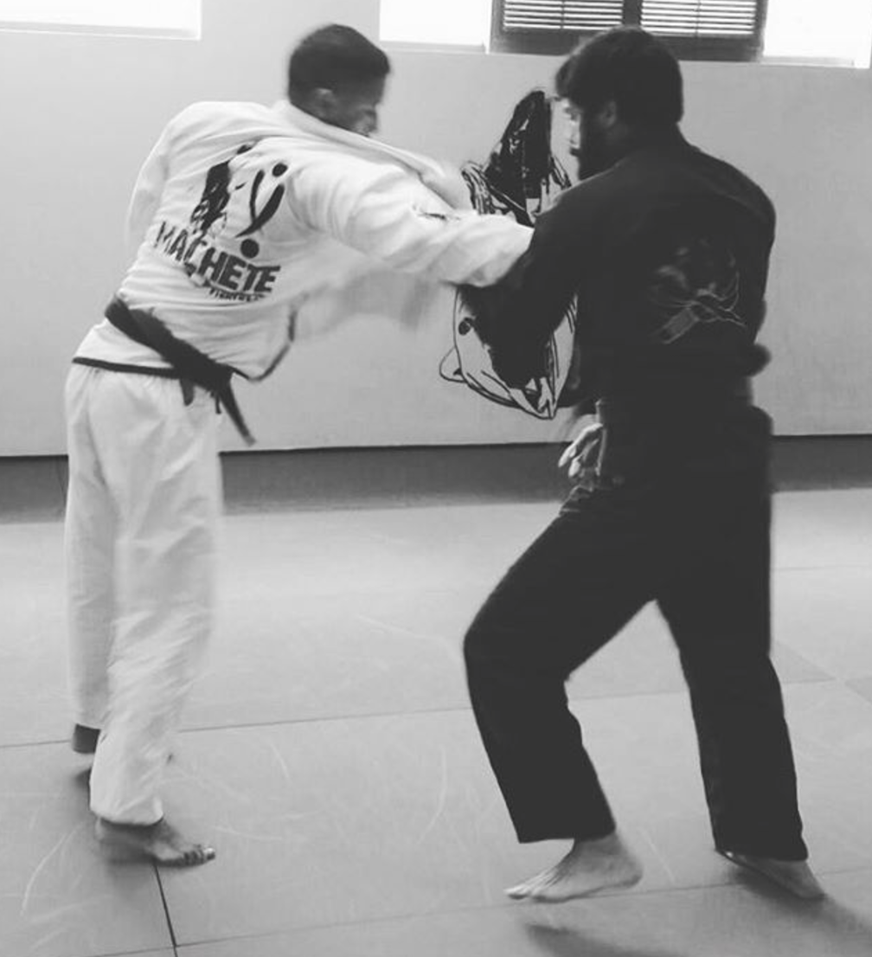

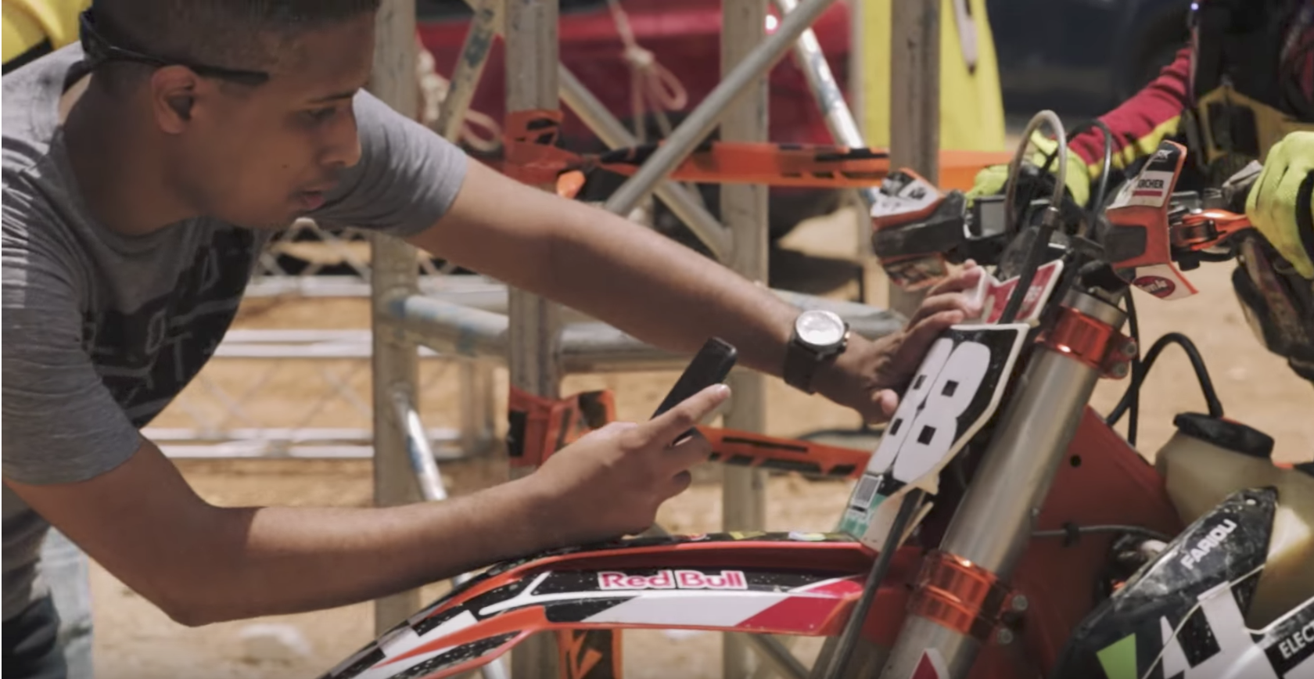
Hector Minaya
Megsoft Consulting
Email: hector@megsoftconsulting.com
Blog: https://medium.com/@hminaya
Twitter: @HectorMinaya

Slide 3

Agenda
Checklist
Day 2
Xamarin & Azure
Demo
Lab
info@megsoftconsulting.com

Slide 4
Before we begin - Checklist
MAC
PC
IDE
Xamarin Studio 6.2.1 or
Visual Studio for MAC Preview (latest)
Java
JDK 1.8.0_121
Android SDK
Android 6.0
iOS SDK
X Code 8.3
IDE
Visual Studio 2017 w/ Xamarin for Visual Studio or
Visual Studio 2015 w/ Xamarin for Visual Studio (4.3.0.795)
Java
JDK 1.8.0_121
Android SDK
Android 6.0
Mac?
If you plan on testing with iOS then you need network access to a Mac w/ X Code 8.3
info@megsoftconsulting.com

Slide 5
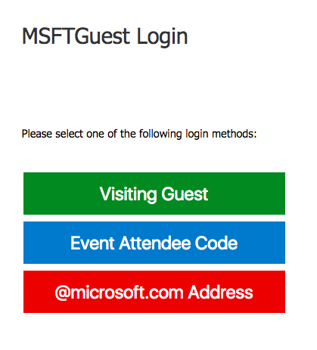
Wifi
SSID: MSFTGuest
Option: Visiting Guest
Username: user123@hotmail.com
Pass: 1856
info@megsoftconsulting.com

Slide 6
Day 2
Content
Materials
Xamarin Forms
PRISM
NavigationService
Commands
PageDialogService
http://bit.ly/DiplomadoXamarinDay2
https://github.com/hminaya/DiplomadoMSDay2
info@megsoftconsulting.com

Slide 7
Today!
info@megsoftconsulting.com

Slide 8
Demo
info@megsoftconsulting.com

Slide 9
Lab
Repository:
https://github.com/hminaya/DiplomadoMSDay3
Requirements:
http://bit.ly/DiplomadoXamarinDay3Tasks
info@megsoftconsulting.com

Slide 10


